Slide 1
Chemical Lane/Monsanto
Also known as, “East Side”, Chemical Yard, Horizon Way, a Brownfield, What’s Next?

Slide 2
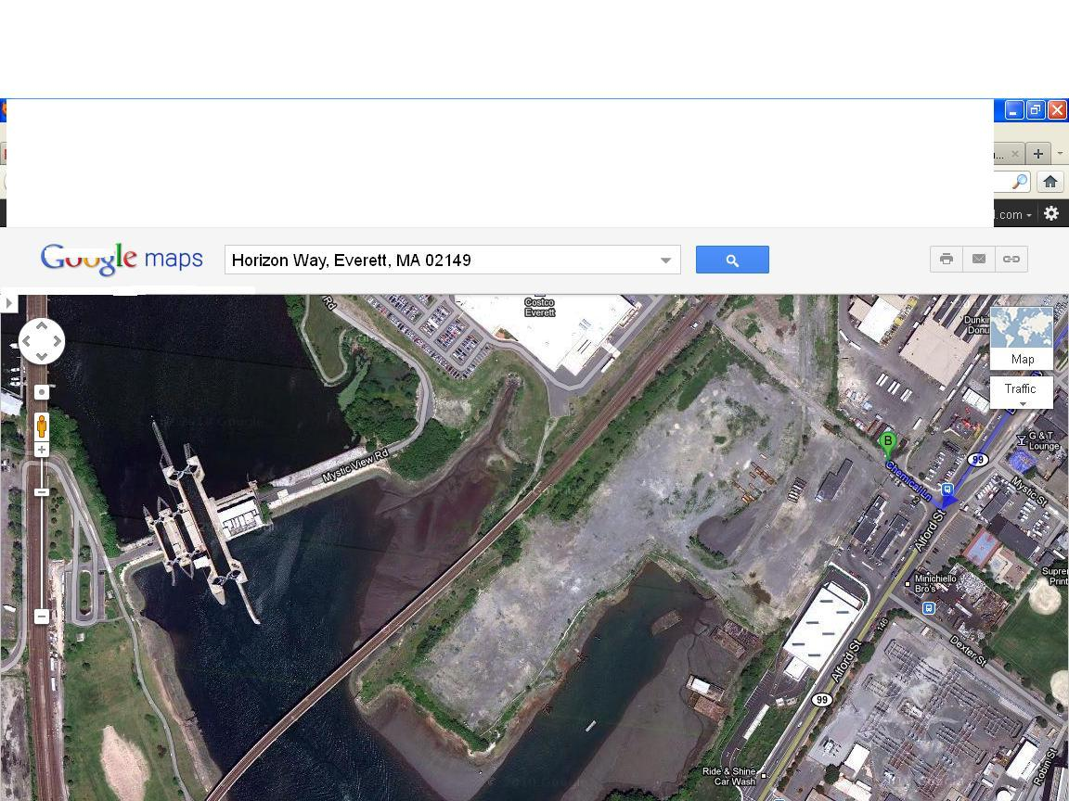
Aerial View of Chemical Lane

Slide 3
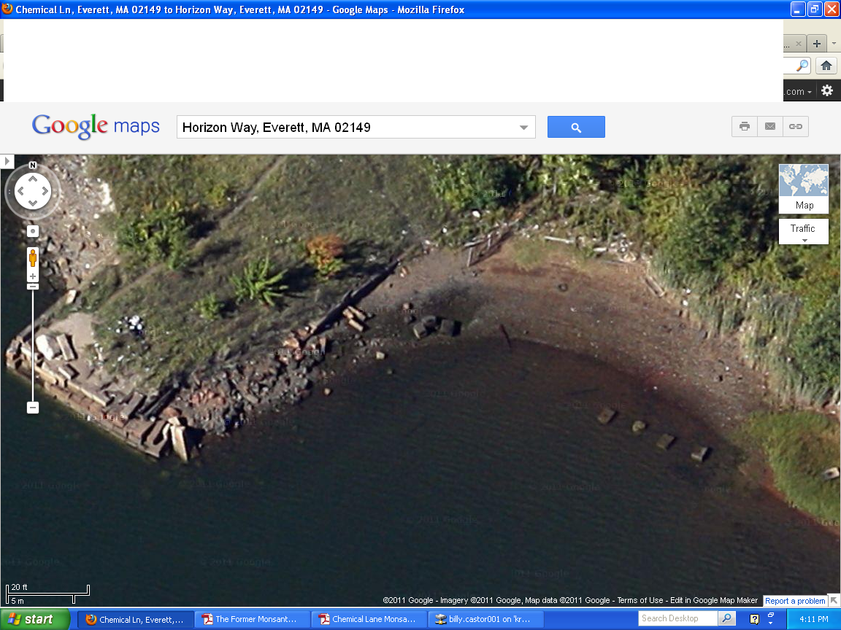
Southern side of Horizon Way

Slide 4
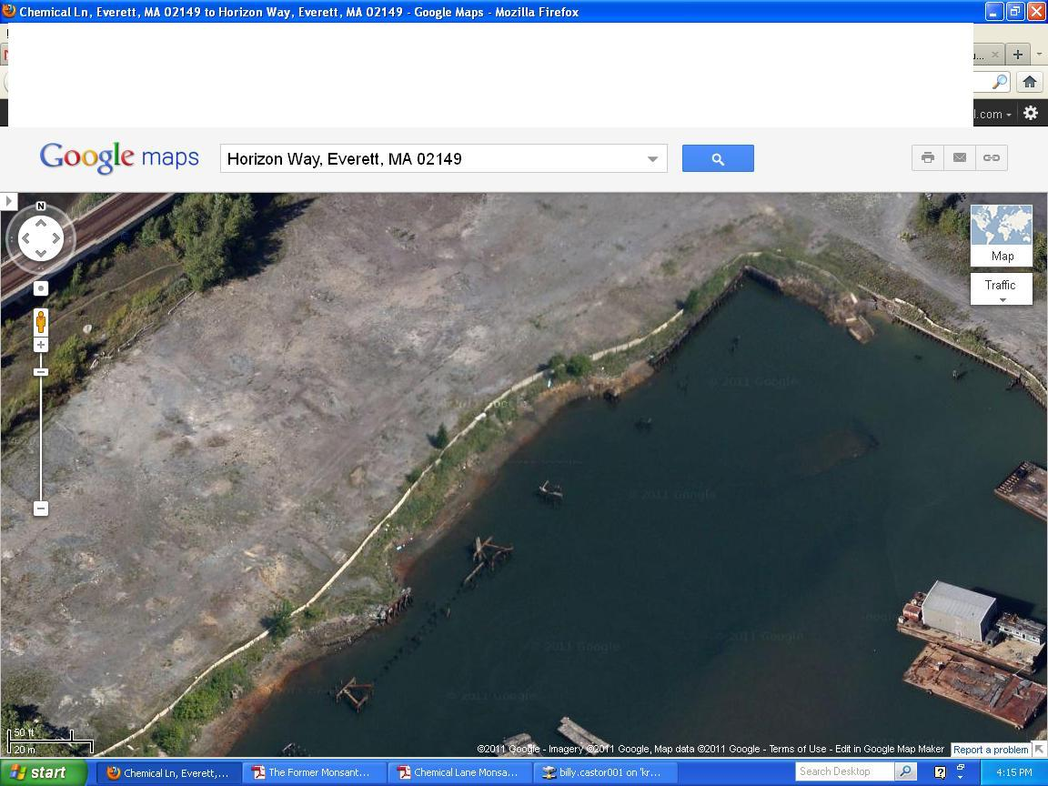
Eastern side of Horizon Way
(Fenced off)

Slide 5
Key Facts
The site is comprised of 30 acres of land on the banks of the Mystic River in the southern portion of Everett.
From 1804- 1983 it has been in the hands of several chemical companies including Monsanto where, hazardous materials were improperly disposed of.
Other incidents like the burning of parts, subway cars, dumping of oil into the ground, and spillage from container ships carrying sulfur occurred from the 1800’s to 1980.

Slide 6
Lingering Issues
No remediation ever took place on the East Side.
The sale in 1983 precluded Mass. Contingency Plan.
The use of the land from 1983-1995 is unknown.
In the sales that took place thereafter restrictions, and easements were removed.
No knowledge currently on the amount of hazardous and toxic materials that are in the ground, sediment, and groundwater.
Details of Mass DEP’s approved plan for remediation are unknown.
Contaminants in the water around Chemical lane in 1999 were still present in 2008.

Slide 7
Laborious Process?
This project has its difficulties and is extremely complex because there are a large multitude of parties involved that interacted with each other through normal business, were required to by law, or operated alone for legal or scientific purposes including; the City of Everett, the current owner, past owners, 4 different chemical companies, two different LSP’s, the 3 companies involved in the last so called remediation effort, Mass. DEP, and Mass. DWM.
It is also quite apparent many policies and regulations slipped through the cracks or were not properly performed. This is observed with the numerous sales of the parcel, sales being paid by cash or mortgage agreements to avoid a 21E site investigation, remediation efforts only done on half the land Monsanto had owned, the validity of the LSP’s work and examination especially in 2000, Mass. DEP’s quick three month investigation, assumed oral plan, and RAO response.
Therefore, it is imperative that we understand the various legal frameworks, the steps in dealing with a brownfield site, urban planning, development and zoning laws, and understand the reports to then figure out the missing links to find a plausible solution as the City did in 1997 with the West Side as regards to the two brownfield properties.

Slide 8
Next Steps
Thoroughly examine Mass. DEP’s investigation of the East Side in 2000.
Analyze the two different water reports, figure out the discrepancies in both reports, and speak to Ek Khalsa for clarification and whether there are new reports or sampling for current estimation of contaminants.
Go over Mass. DEP’s file review process.
Speak with CDM of Cambridge, MA, the LSP that was in charge in 1999-2000 for detail of the work.
Meet with Everett’s Assessors, Inspectional Services, and Building Dept.
Work with Officer Johnston.

